Slide 1
08/02/2022
Aim:
Be able to apply BIMDAS with 4 operations.
Be able to multiply rational numbers using a written strategy.
Plan:
Daily review:
BIMDAS
Multiplication strategies.

Slide 2
BIMDAS
B: ______________
I: ______________
M: ______________
D: ______________
A: ______________
S: ______________
When only m__________________ and d_____________
work _________ to __________
When only a__________________ and s_____________
work _________ to __________
Notes:
Worksheet 1

Slide 3
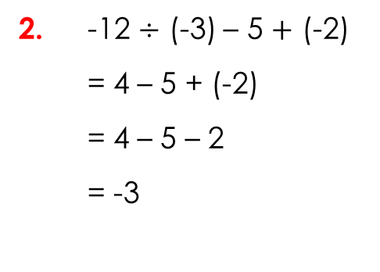

I do: exercise books.
1. 2 $×$ (-3) – 3 $×$ (-2)
= -6 – (-6)
= -6 + 6
= 0
Brackets and indices.
Identify the multiplication and division.
Do the multiplication and division.
Deal with double signs.
Complete the addition / subtraction (left to right).
2. -12 $÷$ (-3) – 5 $+$ (-2)
= 4 – 5 + (-2)
= 4 – 5 – 2
= -3
Brackets and indices.
Identify the multiplication and division.
Do the multiplication and division.
Deal with double signs.
Complete the addition / subtraction (left to right).

Slide 4
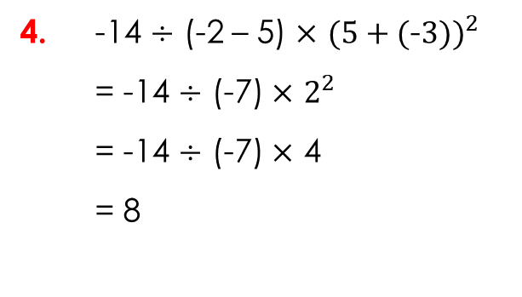

I do: exercise books.
3. 2 $+$ ${(\text{−}3)}^{2}$– (3 – (-2))
= 2 + 9 – 5
= 6
Brackets and indices.
Identify the multiplication and division.
Do the multiplication and division.
Deal with double signs.
Complete the addition / subtraction (left to right).
4. -14 $÷$ (-2 – 5) $×$ ${(5+(\text{−}3))}^{2}$
= -14 $÷$ (-7) $×$ $2^{2}$
= -14 $÷$ (-7) $×$ 4
= 8
Brackets and indices.
Identify the multiplication and division.
Do the multiplication and division.
Deal with double signs.
Complete the addition / subtraction (left to right).

Slide 5
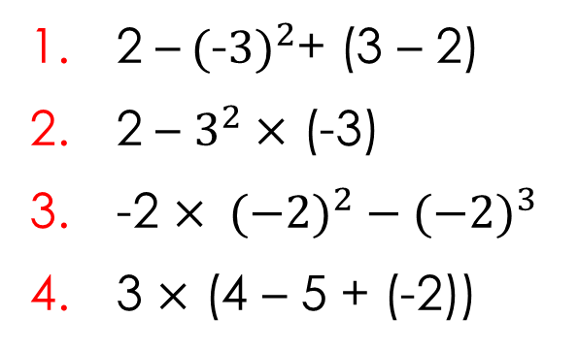
we do, you do: exercise books.
1. 2 –${(\text{−}3)}^{2}$+ (3 – 2)
2 – $3^{2}×$ (-3)
-2 $× {(−2)}^{2} − {(−2)}^{3}$
3 $×$ (4 – 5 + (-2))
Brackets and indices.
Identify the multiplication and division.
Do the multiplication and division.
Deal with double signs.
Complete the addition / subtraction (left to right).

Slide 6
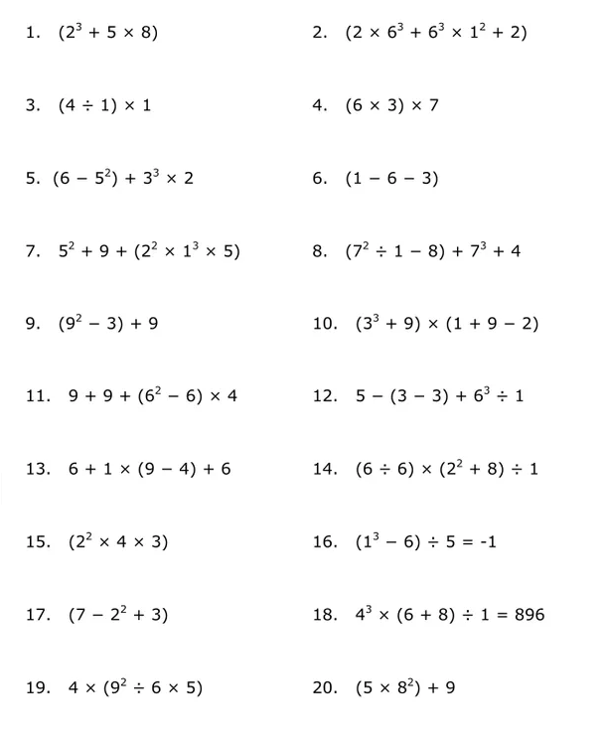
Independent practice: exercise books.
T/F
T/F
Notes:
Worksheet 2

Slide 7
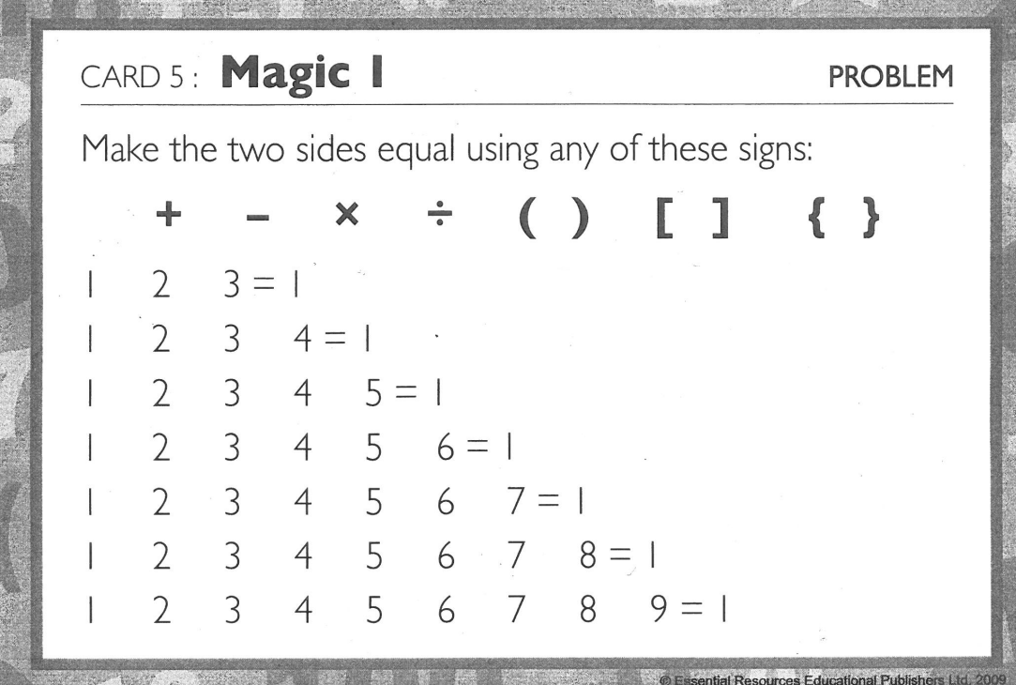
Notes:
Worksheet 3

Slide 8
Multiplication strategies - rational numbers.
There are a number of written strategies for multiplying rational numbers.
The standard algorithm:
36 x 24
2
36
X 24
1
4
14
Use the ones digit first
2
7
0
Use the tens digit second.
Don’t forget to put a zero
864
Add them up

Slide 9
Standard algorithm: 48 x 63

Slide 10
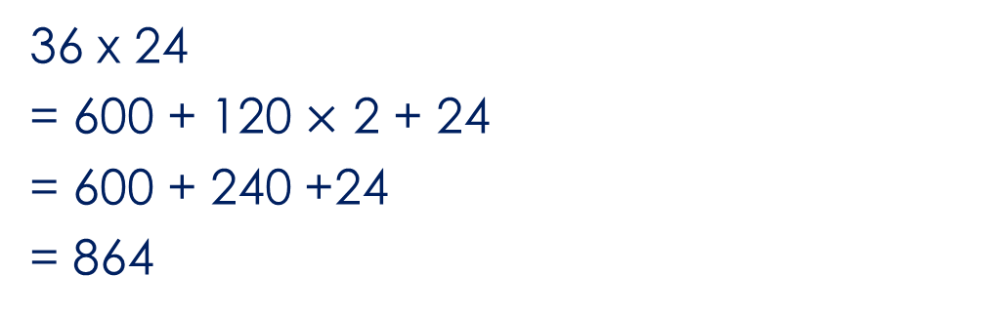
The grid method:
36 x 24
30
6
600
120
20
120
24
4
36 x 24
= 600 + 120 $×$ 2 + 24
= 600 + 240 +24
= 864

Slide 11
Grid method: 48 x 63

Slide 12
The lattice (Chinese) method:
36 x 24
3
6
0
1
6 x 2 =12
2 x 3 = 06
6 x 4 = 24
3 x 4 = 12
Add the diagonals
6
2
2
1
2
8
2
4
4
6
4
36 x 24
= 864

Slide 13
Lattice method: 48 x 63

Slide 14
The doubling (Egyptian) method:
36 x 24
Left (36)
1
2
4
8
16
32
Right
24
48
96
192
384
768
36 = 32 + 4
36 x 24
= 96 + 768
= 864

Slide 15
Doubling method: 48 x 63

Slide 16
Independent practice worksheets.
Notes:
Printable worksheet with lesson

